Slide 1

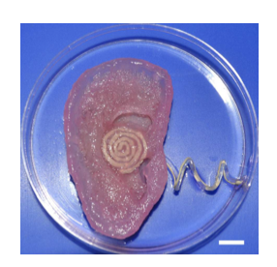
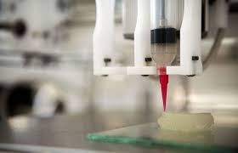

Development of a 3D Printed Bionic Ear
~Prajin tanneru

Slide 2
Why bionic ear?
It represents merging cutting edge tech with biological principles for human aid
Quality of life improvements for individuals with impairments Immense significance in the field of regenerative medicine and biomedical engineering. It’s impact of this technology is crucial for fostering further research in the pursuit of enhancing human health

Slide 3
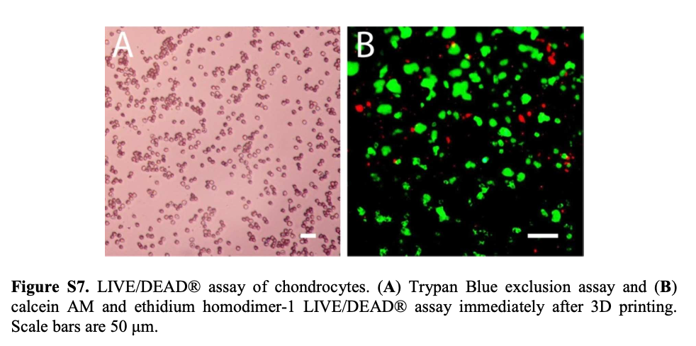
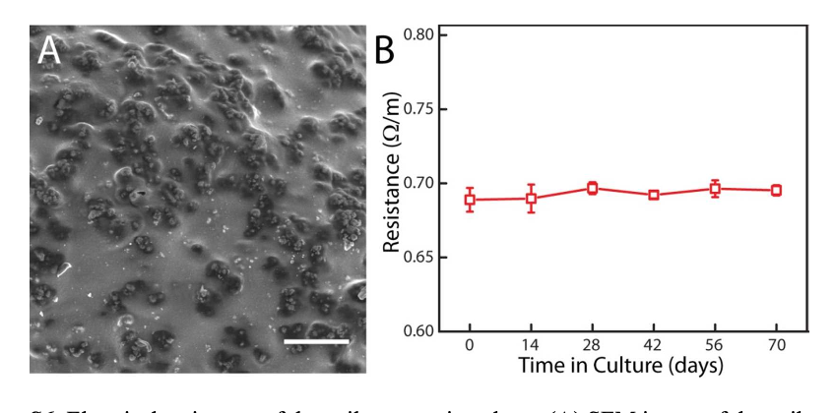
Chondrocyte Culturing:Isolation and cultivation of chondrocytes from bovine articular cartilage, including details of medium composition and culture conditions.
Alginate Formulation:Preparation of the hydrogel matrix using alginate and chondrocyte seeding, emphasizing the importance of scaffold biocompatibility.
3D Printing Process: Layer-by-layer deposition of functional materials Culture conditions: Maintaining temperature, CO2 levels, and nutrient supply to facilitate cell growth
Methodology &procedure

Slide 4
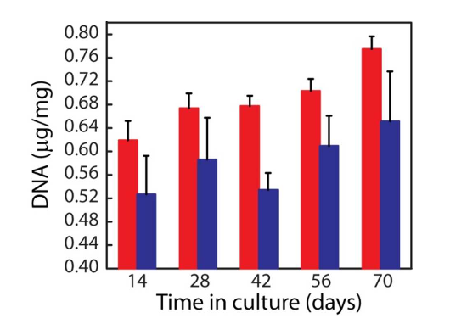
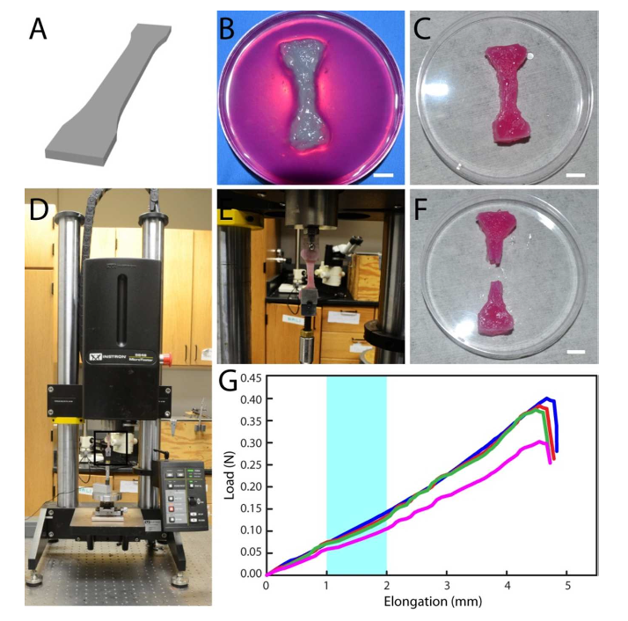
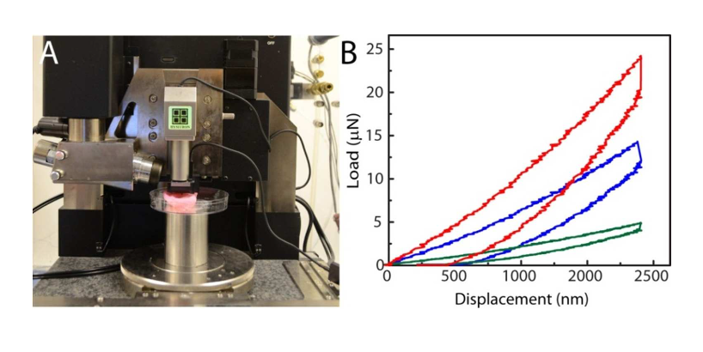
The ear underwent various test to ensure its functionality Biochemical:chondrocyte proliferation in the bionic ear under culture was determined Histological:several rounds of staining and washing Mechanical:To check the structural integrity Electrical & radio: To check its sensitivity
Testing & analysis

Slide 5
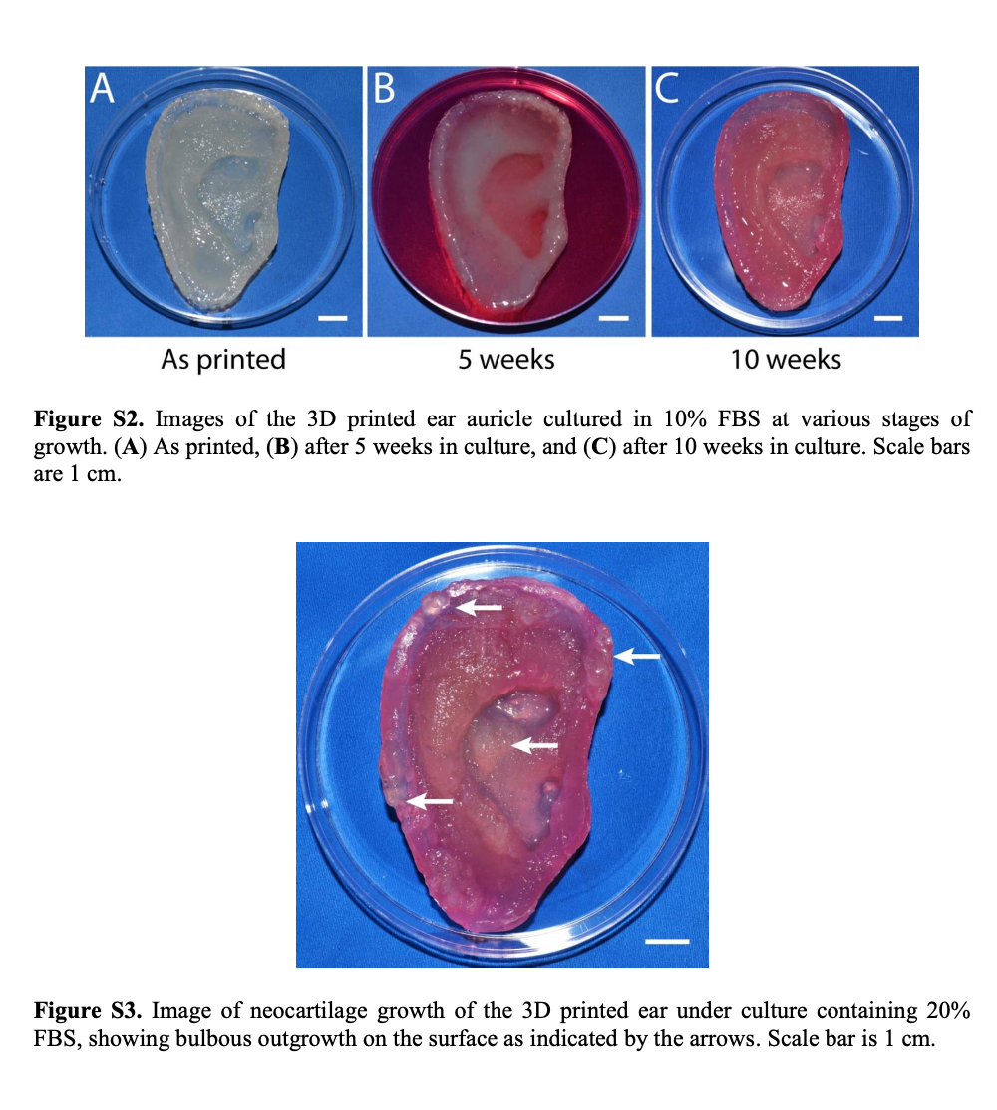
Results
Results: the development of the bionic ear through images captured during its growth in a laboratory setting. The images depicted changes in its appearance over time, illustrating the formation of new cartilage and the gradual degradation of the scaffold material.
Applications: The bionic ear holds promise for diverse applications, particularly in assisting individuals with hearing impairments and potentially inspiring the development of innovative medical devices leveraging tissue engineering techniques.

Slide 6



